Slide 1
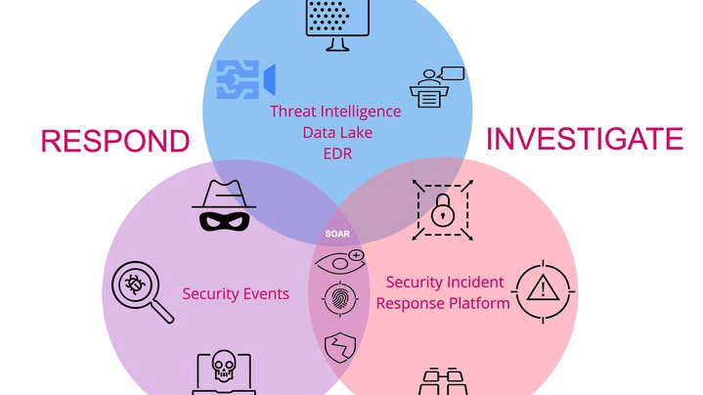
CYBERSECURITY FRAMEWORK
Threat Score
Calculation
A Comprehensive Framework for Cybersecurity Threat Assessment
MULTI-FACTOR ANALYSIS
SCORING RANGE
6 Components
0-100 Points

Slide 2
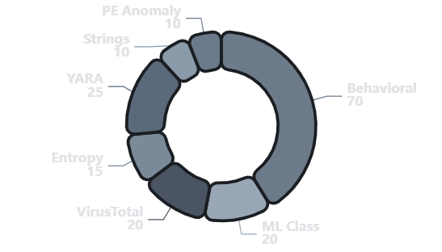
SYSTEM ARCHITECTURE
Threat Scoring Framework
The Threat Score Calculation system aggregates six critical security indicators into a unified scoring framework, providing comprehensive assessment of potential threats through multi-layered analysis.
Component Distribution
170+
100
3
Total Points
Capped Score
Risk Levels
Aggregated
Normalized
Classification
Signature-Based Detection
Dynamic Analysis
YARA rules provide pattern matching against known threat signatures, with scoring weighted by severity levels from critical to low.
Behavioral monitoring tracks runtime activities, system modifications, and network communications to identify malicious behavior patterns.
Key Benefits
Comprehensive Coverage: Multiple detection vectors reduce blind spots.
Machine Learning
Threat Intelligence
Scalable Assessment: Normalized scoring enables consistent evaluation.
ML classification analyzes file characteristics and behavioral patterns to identify previously unknown threats with confidence scoring.
VirusTotal integration leverages collective threat intelligence from multiple security vendors to enhance detection accuracy.
Actionable Intelligence: Clear risk levels guide response priorities.

Slide 3
PRIMARY DETECTION
YARA Matches & Behavioral Analysis
YARA Pattern Matching
Behavioral Analysis
Signature-Based Detection
Dynamic Monitoring
YARA rules provide pattern-based detection against known threat signatures. Each match contributes points based on rule severity, with critical threats receiving maximum weight.
Runtime monitoring tracks dynamic behavior patterns during execution. Suspicious activities contribute to a behavior score, which is then weighted at 70% for the final calculation.
Severity
Points
Example
File System
Network
25
Modifies system files
C&C communication
Critical
APT malware
15
Memory
Evasion
High
Ransomware
Code injection
Anti-analysis
Medium
8
PUA
Calculation Formula
Low
3
Adware
behavior_score × 0.7 = Final Points
Example: 85 × 0.7 = 59.5 points
Cumulative Scoring
Highest Weight Component
Multiple YARA matches accumulate points. A sample with critical and medium matches would score 25 + 8 = 33 points.
At 70 points maximum, behavioral analysis is the most significant indicator of malicious intent.

Slide 4
ADVANCED DETECTION
Entropy & Machine Learning Classification
Entropy Analysis
ML Classification
Obfuscation Detection
Predictive Analysis
Entropy measurement identifies obfuscation techniques like packing and encryption, which are common in malware to evade signature-based detection.
Machine learning models analyze file characteristics and behavior patterns to identify previously unknown threats based on trained features.
10
15
20
10
Packed
Encrypted
Malicious
Suspicious
High entropy
Maximum entropy
Score × confidence
Score × confidence
Entropy Scale
Confidence Multiplier
0-3
Normal
High Confidence (80-100%)
×1.0
3-6
Packed
Medium Confidence (60-79%)
×0.8
6-7
Encrypted
Low Confidence (40-59%)
×0.6
Example: Malicious w/ 85% conf. = 20 × 0.85 = 17 points
Why Entropy Matters
Adaptive Intelligence
High entropy often indicates intentional obfuscation, a common malware tactic to hinder analysis.
ML models continuously learn from new threats, enabling detection of evolving malware families.

Slide 5
INTELLIGENCE GATHERING
VirusTotal Integration & Suspicious String Analysis
VirusTotal Integration
Suspicious Strings
Collective Intelligence
Static Analysis
VirusTotal aggregates detection results from 70+ security vendors. The score reflects the ratio of positive detections to total engines scanned.
Static string analysis identifies suspicious text patterns like URLs, file paths, and registry keys that may indicate malicious functionality.
Calculation Formula
Scoring Formula
(detections / total) × 20
min(suspicious_count, 10)
Each unique suspicious string adds 1 point, capped at 10.
Example: 35/70 engines × 20 = 10 points
Common Suspicious Strings
0-2
3-15
16-20
Malicious URLs
Registry keys
Low Risk
Medium Risk
High Risk
File paths
IP addresses
Crowdsourced Detection
Quick Indicator
Provides broad-spectrum validation from multiple security vendors.
Rapid indicator of potentially harmful functionality without execution.

Slide 6
STRUCTURAL ANALYSIS
PE Anomalies & Structural Analysis
PE Anomaly Detection
Common PE Anomalies
Structural Integrity Analysis
5
Entry Point Mismatch
Portable Executable (PE) analysis identifies structural abnormalities in Windows executables that may indicate tampering or malicious compilation.
Entry point outside code section, often indicating packed/encrypted content.
Scoring Formula
6
Overlay Data
2 points × anomaly
Excessive data appended after PE, common in packed/obfuscated malware.
Maximum: 5 anomalies (10 points)
7
Import Table Anomaly
1
Malformed Header
2
Section Mismatch
Sparse or obfuscated import table suggesting API obfuscation.
Invalid PE headers
Section size/offset errors
8
Resource Manipulation
3
Invalid Checksum
4
Dual Extension
Checksum verification fails
Trickery like .jpg.exe
Executable resources or malformed resource sections.
Structural Red Flags
PE anomalies reveal intentional manipulation, often for evasion or malicious purposes.

Slide 7
RISK ASSESSMENT
Classification Thresholds & Risk Levels
BENIGN
SUSPICIOUS
MALICIOUS
Low Risk
Medium Risk
High Risk
0-39
40-69
70-100
Points
Points
Points
Characteristics
Characteristics
Characteristics
Minimal or no suspicious indicators
Multiple low-medium indicators
High-severity indicators present
Clean behavioral analysis
Moderate behavioral concerns
Definitive malicious behavior
No structural anomalies
Some structural anomalies
Multiple detection hits
Action
Action
Action
✓ Safe for execution
⚠ Requires further review
⛔ Block immediately
Threshold Calibration
Score Normalization
Risk Communication
Tuned to minimize false positives while maintaining high sensitivity.
Aggregated score is capped at 100 for consistent interpretation.
Color-coded system enables rapid decision-making.

Slide 8
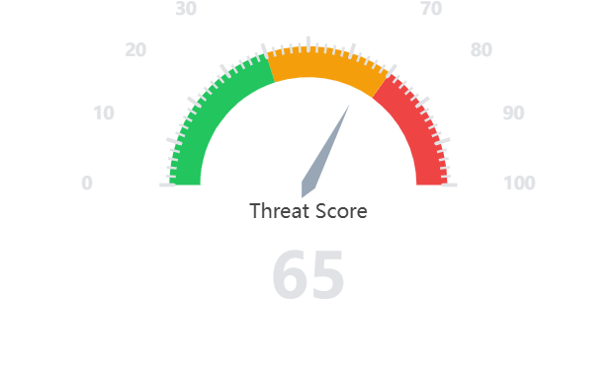
VISUAL REPRESENTATION
Threat Gauge Design
Threat Level Gauge
Visual Design Principles
G
Green Zone (0-39)
Instills confidence. Clear visual cue for safe files, reducing analyst workload.
Y
Yellow Zone (40-69)
Demands attention. Signals uncertainty and need for deeper investigation.
R
Red Zone (70-100)
Triggers urgency. Immediate action required to prevent potential damage.
Gauge Components
0
Scale Range
0-100 scale with color zones
Dynamic Needle
Indicates current score
Implementation Benefits
Color Coding
Traffic light paradigm
Rapid Assessment
Universal Understanding
Decision Support
Instant threat evaluation
No technical expertise required
Guides response actions

Slide 9
PRACTICAL APPLICATION
Calculation Examples
Ransomware
PUA/PUP
Utility Tool
Final: 92 pts
Final: 54 pts
Final: 18 pts
YARA (Critical)
25
YARA (Medium)
8
YARA (Low)
3
Behavioral
45
Behavioral
32
Behavioral
12
Entropy (Encrypted)
15
Entropy (Packed)
10
Entropy (Normal)
0
ML (Mal, 90%)
18
ML (Susp, 75%)
8
ML (Benign)
0
VirusTotal (65/70)
19
VirusTotal (12/70)
3
VirusTotal (1/70)
0
Strings
5
Strings
7
Strings
3
PE Anomalies
4
PE Anomalies
2
PE Anomalies
0
⛔ MALICIOUS
⚠ SUSPICIOUS
✓ BENIGN
Scoring Methodology
Aggregation
Normalization
Weighting
Classification
Sum all component scores for a total.
Cap the final score at 100.
Behavioral analysis has the highest weight.
Map score to risk level via thresholds.

Slide 10
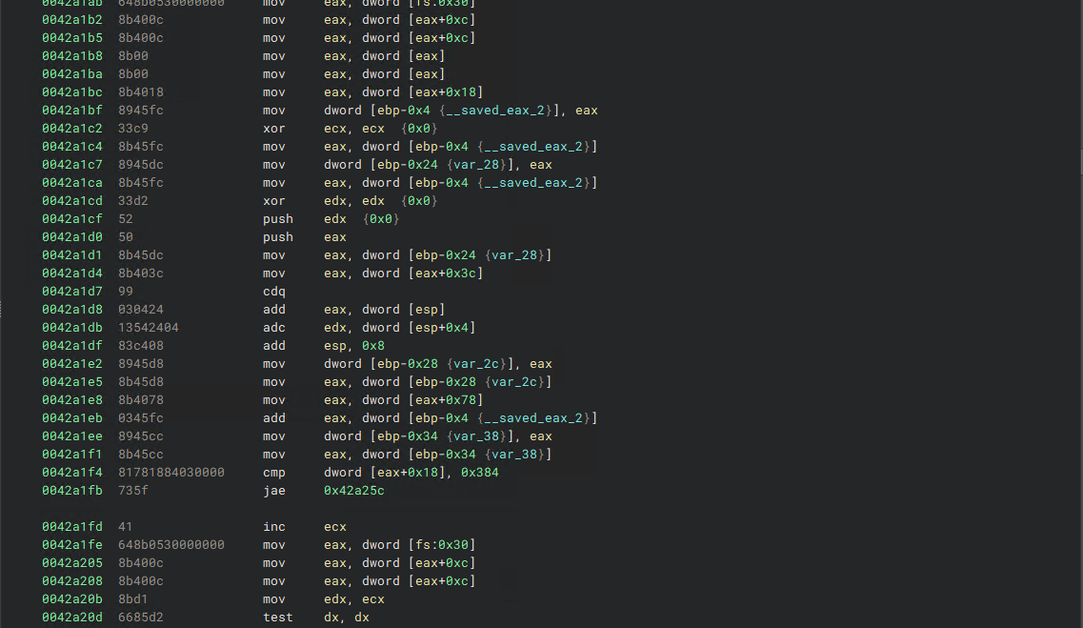
FRAMEWORK COMPLETE
Implementation
& Next Steps
Ready for Production
Customization Options
The framework is designed for immediate deployment in SOC environments, providing analysts with a systematic approach to threat assessment.
Organizations can fine-tune thresholds based on risk tolerance and integrate with existing security orchestration platforms.
Key Implementation Areas
Endpoint Protection
Network Security
Malware Analysis
Real-time file scoring
Gateway inspection
Automated triage
Comprehensive threat assessment through multi-factor analysis

